Slide 1

1.3 Data Extraction & Processing
© London Academy of IT, www.londonacademyofit.co.uk

Slide 2
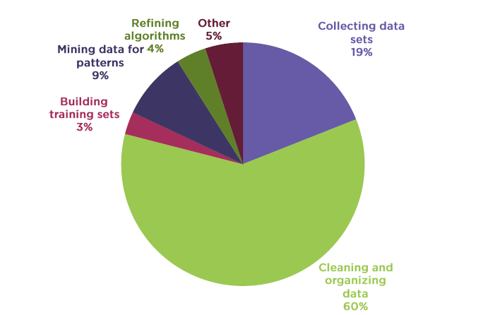
Data Science Project Timelines

Slide 3
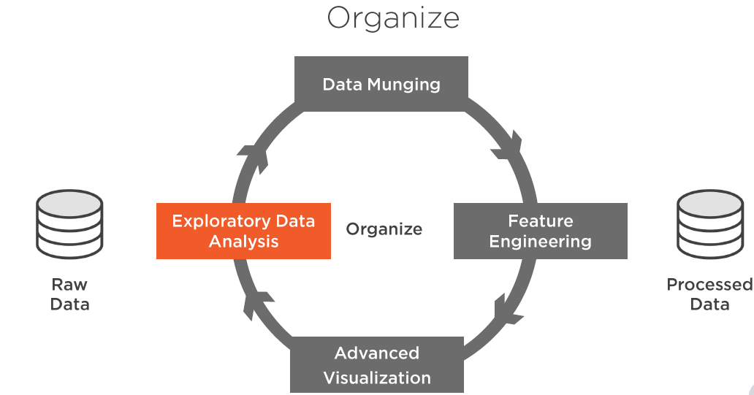
Data Science With Python

Slide 4
Exploratory Data Analysis
Basic Structure
Summary statistics
Distributions
Grouping
Crosstabs, Pivots
Tools Overview

Slide 5
Tools for Data Analysis
Python – NumPy
Python - Pandas

Slide 6
Python - NumPy
Fundamental tool for scientific computing
Very efficient array operations
Can work with multidimensional arrays and matrices
High level mathematical functions

Slide 7
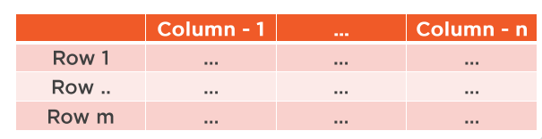
Python - Pandas
Developed on top of NumPy
Data structures and operations on tabular data (Pandas dataframe)
Data visualization using Matplotlib

Slide 8
Basic Structure
How many rows or observations
How many columns or features
Column data types
Explore head or tail

Slide 9

Basic Structure - Demo
Demo

Slide 10
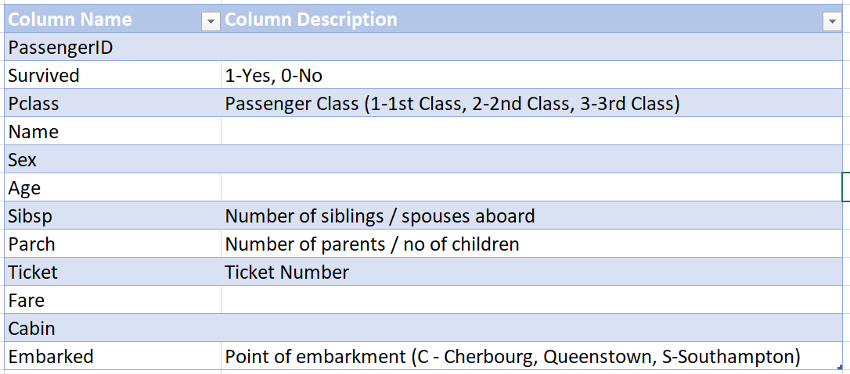
Sample Dataset - Details

Slide 11
Pandas - Demo
Selection, Indexing and Filtering using Pandas Demo

Slide 12
Summary Statistics
Numerical
Categorical
Centrality measures(mean, median)
Dispersion measures (range , percentiles, variance, standard deviation)
Total count
Unique count
Category counts and proportions
Per category statistics

Slide 13
Centrality Measures
One number to present entire set of values
Number central to the data
Central tendency

Slide 14
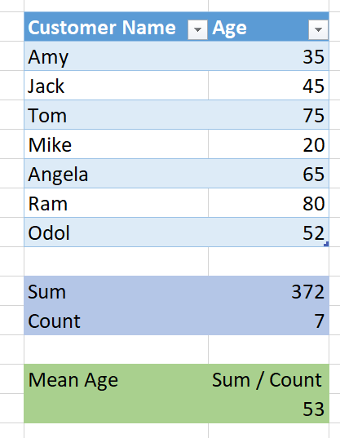
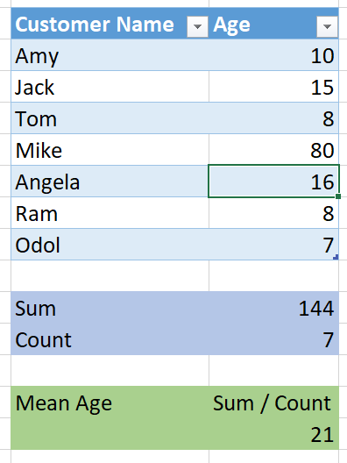
Mean ( Average) – Affected by extreme values

Slide 15
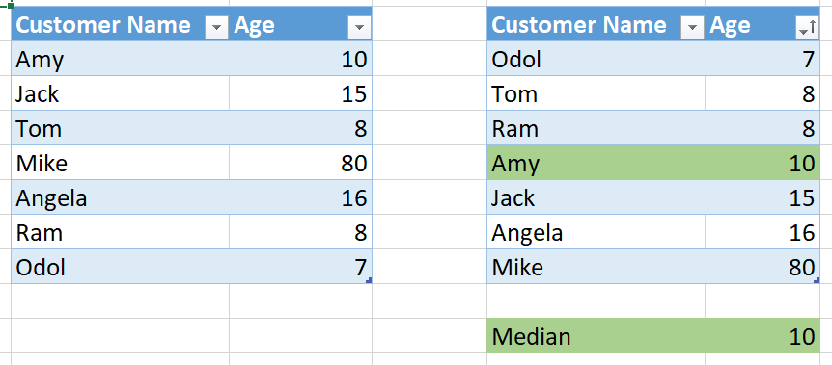
Median – Middle value in the sorted list

Slide 16
Spread / Dispersion measure
How spread out values are from central value
Variability

Slide 17
Range
Difference between maximum and minimum

Slide 18
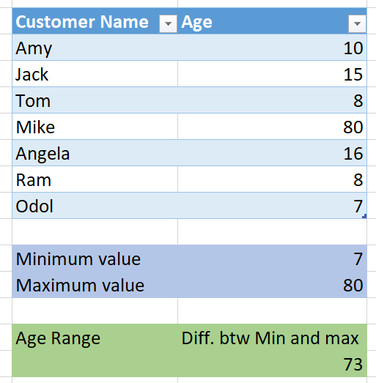
Range – Affected by extreme values

Slide 19
Percentiles
X percentile is y, means x% of values are below y
50 percentile is 10 means, 50 % of values are below 10
25th, 50th and 75th
Bucket -1 : Below 25th
Bucket -2 : 25th – 50th
Bucket -3 : 50th – 70th
Bucket -4 : above 75th
Quartiles

Slide 20
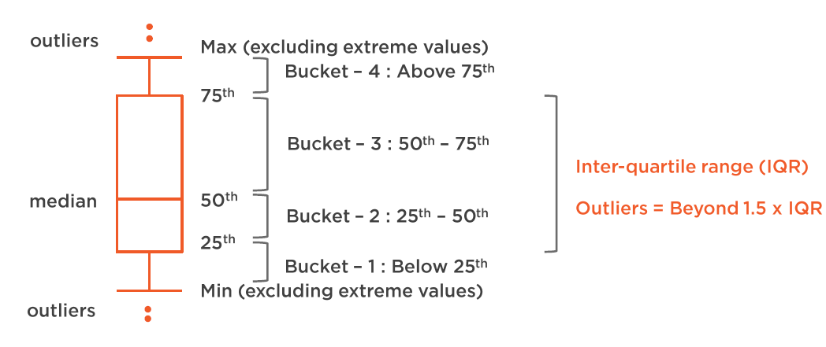
Box – Whisker Plot

Slide 21

Variance
Measure of variability
How far each value in list from mean value
Small variance = less spread
High variance = large spread
Affected by extreme values
Unit is not clear

Slide 22

Standard deviation
Unit is same as that of that feature
Low standard deviation = low spread
High standard deviation = high spread

Slide 23
Summary Statistics - Demo
Summary statistics for numerical features using Python NumPy and Pandas

Slide 24
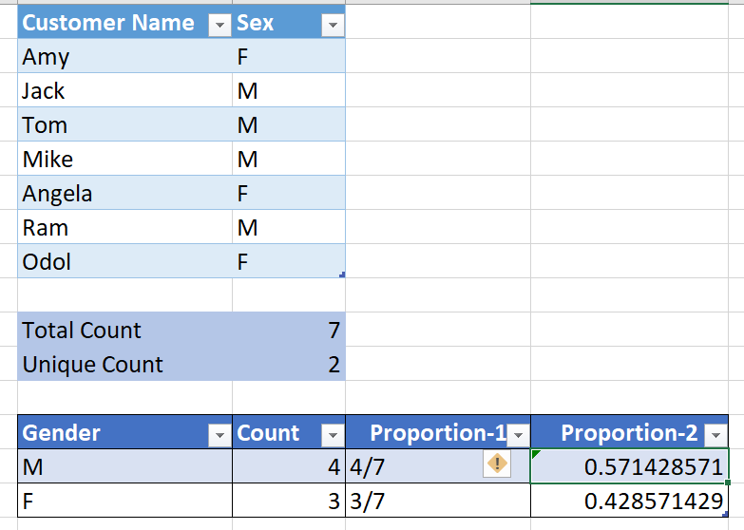
Count and Proportions

Slide 25
Summary Statistics - Demo
Summary statistics for categorical features using Python NumPy and Pandas

